Slide 1

Col
College of Arts
Department of English Language and Literature
ENGL 155

Slide 2
Unit 3 Paraphrasing, Summarizing, Synthesizing, and Citing sources
Prepared by Adam Tarawneh and Fadi Asker

Slide 3
Unit 3: Paraphrasing, Summarizing, Synthesizing, and Citing Sources
In the previous unit and course ENGL 154, we learnt the basics of how to write an Essay. We were able to establish how all the parts of an essay relate and interact with each other. Now that we covered the structure, our focus should shift to the quality of an essay’s content and that is where methods such as Paraphrasing, Summarizing, Synthesizing, and Citing Sources come in hand. Such methods allow us to cite (include the works of others to enhance, strengthen, build or prove our own ideas in a more constructive approach. Throughout this unit, we will define each one of these methods and demonstrate how to practically use them.

Slide 4
When and why to use information from other sources
While most of the essay must be our own words; there are many reason why we should lean to other sources in our own work. Here are the most common of them:
1- Credibility: This means that your words can be trusted, as it is based on reliable sources. This is a very important quality to have in your writings, especially when trying to deliver a point. A credible writing makes it easy for the reader to trust and believe the content of your work. For example, If I was to state my own opinion on a scientific matter, then it would be nothing more than my own opinion. However; if I was to refer to an established Scientist professionalized in this matter and align my statement with it, then it would be easier for the reader to understand where your point is coming from and what it aims to achieve.
2- Evidence: Any statement that we aim to deliver through our essay needs to be met with proof, so that the reader can consider the ideas that you propose throughout the essay. We make our statements on the thesis and use the body paragraphs to support it. Referring to other sources allows you to use facts over opinions to support your idea.
3- Being constructive: Most ideas that we propose through an essay are usually built over a pre-existing idea from another source. Utilizing these pre-existing ideas along with your own work makes it a lot more convenient for the reader to follow your own work.

Slide 5
How to use information from other sources
Citing: The action of indicating that a writer’s words are not original but are from another source.
As in the definition above, we CITE the works of others into our own work. That can be done in two ways.
1- Direct Quotation: Using the exact words from the original source without changing the way the ideas are expressed. When we quote from others, we need to use quotation marks around the borrowed words, as seen in the example below:
EX. Ahmed states, “Anyone can be what they want to be if they wilfully they can do so.”
2- Paraphrase: Restating the ideas from the original source into the writer’s own words (Same ideas from the original expressed differently)
Ex. Ahmed believes that having will allows to become whatever you would like to be.
NOTE: Using information from other sources without giving credit to the source you got the information from is called Plagiarism. It is considered as academic theft!
Open to page 55 in your book for more examples that apply these methods.
For further details, refer to page 54.

Slide 6
Practice: Use a direct quotation or paraphrase Ahmed’s work into your own.
Ahmed’s Work:
If a student studied properly and processes the information as soon as it is covered, then achieving an A becomes an easy task.
-Remember, the writer of this source is Ahmed. Whether you are directly quoting or paraphrasing Ahmed’s work, make sure that you properly give Ahmed credit for the words/ideas that is being borrowed, so that you avoid plagiarising Ahmed’s work.
Direct Quote:
_________________________________________________________________________________________
Paraphrase:
_________________________________________________________________________________________
For support on solving this practice, refer to page 55 and 56

Slide 7
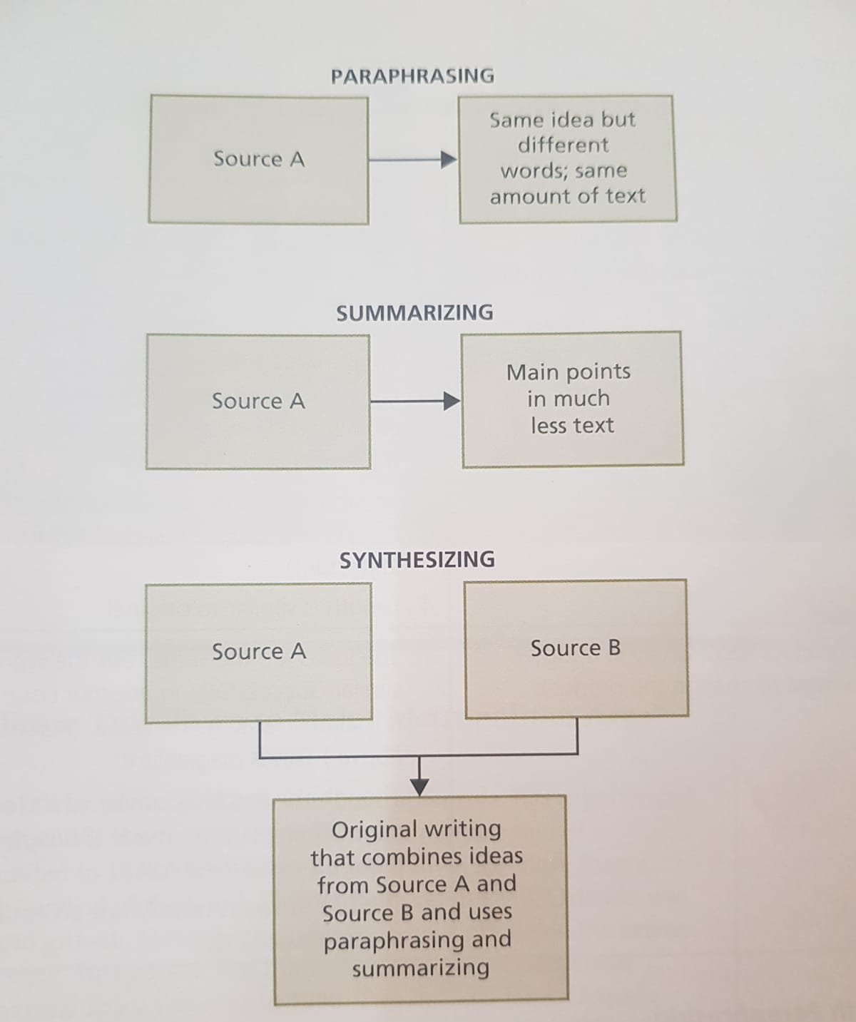
Paraphrasing, Summarizing, Synthesizing
In essays, we often base our information on something that we read. Therefore, it is important to learn how to:
1- Paraphrase: Use different language to say the same thing.
2- Summarize: Express the same idea in fewer words.
3- Synthesize: Combine information from two or more sources.
As seen in the illustration from the book in page 57

Slide 8
Basic steps for Paraphrasing
1- Read the source material and understand it well.
2- Decide which material you want to use.
3- Think of a different way to say that information.
4- Use different and original vocabulary.
5- Use different and original sentence structure.
Open to page 58 and see the examples of paraphrasing

Slide 9
Summarizing
When you summarize from a source, you do not include all the information it. Instead, you use only the parts that you think are the most Important. This means that a full article could be summed into a paragraph or a book into an essay. Therefore, a summary is always shorter than the original source.
Note: When summarizing, you are not adding your own ideas
To recap:
A summary is a shorter version of a text.
It contains the main ideas of the text written in a brief and simple way.
We use it when taking information from other writers (sources).
We do not add any of our own ideas.
With long texts we focus on Topic Sentences and usually leave out any supporting detail.

Slide 10
Basic steps for Summarizing
1- Read the source material and understand it well.
2- Decide which part of the source material are the most important.
3- Put the important parts in the same order as they appear in the original.
4- Paraphrase, using different grammar and vocabulary.
For further details, refer to page 61.

Slide 11
Sample summaries
Original
Many languages do have a standard form – particularly on paper – and this is what we learn, but they probably also have a variety of regional dialects and social styles, and many are the products of the historical mingling of other languages. (41 words)
Summary
Many languages have standard forms, regional dialects and various social styles. They are often the result of mixing with other languages. (21 words)

Slide 12
Complete the exercises on Paraphrasing and Summarizing
Paraphrasing page 60
Summarizing page 63
Refer to the slides if you need more help solving these exercises or open the book to pages 54-63.

